Slide 1
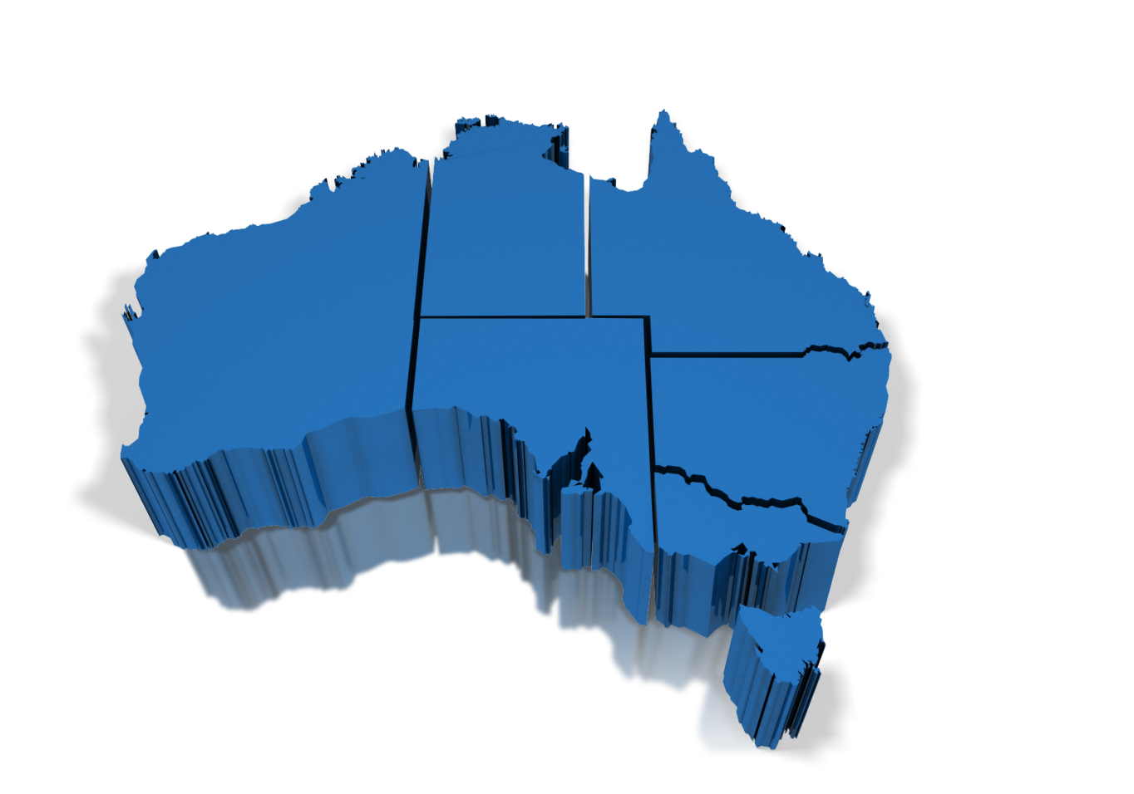
Development of Tools for the Design of Customizable Catchment Areas
and
the Analysis of
Geographic Variation in
Health Care
PhD Candidate
Ludovico Pinzari
Supervisor
Prof. Federico Girosi
Notes:
First of all, I’d like to welcome everyone and thank you very much for being here for this COC presentation. I’m Ludovico Pinzari and today I’m going to talk about a hot topic in Health Research:
The identification of areas suitable to study the Geographic Variation in Health Care Delivery. This research is supported by The Australian Institute of Health and Wealfare and the Department of Health. The scope is to develop tools and methods for use in reporting on the performance of primary helath care. We access the data from the offices of AIHW in Sydney where we spend almost all week except Saturday and collaborate actively with the Data Analyst group.

Slide 2
Outline
Motivation
Geographic Variation
Research Case
Australia – Medicare Local & Primary Health Network
Research Objectives
Literature Review
Access to Health Care
Limitations
Potential Accessibility Vs Revealed Accessibility
Research Methodology
PHN peer Grouping – RPCSA Design – Supply/Demand
Research
Architecture & Plan
Notes:
But before I get started, What I’d like to do now is give you a brief overview of this presentation:
- Firstly I will introduce the problem of Geographic Variation in Health Care; and Why is it important to select an appropriate geographic unit to study the variation of health related indicators.
- In the second and third part of my presentation
I will consider the case of Australia and discuss the outcomes of this research.
Then I will move on to present some of the methodologies provided in the literature and their limitations.
Finally I’m going to suggest some solutions to solve these difficulties and the Research plan to accomplish this work.

Slide 3
Geographic Variations in Health Care Delivery
Comparisons of patterns and costs of health care delivered in different geographic regions that determine:
How much rates of utilization or costs of services vary across geographic settings ?
How much of that variation is unwarranted ?
Unwarranted variation has been defined as:
“… variation in the utilization of health care services that cannot be explained by variation in patient illness or patient preferences.”
Professor John Wennberg (2010) “Tracking Medicine, A Researcher’s Quest to Understand Healthcare.”
Notes:
So What is geographic variation in Health Care ?
It is an effort to compare patterns and costs of health care delivered in different geographic regions.
An what you want to try to do is to determine how much the rates of utilization or costs of care vary in different geographic settings.
And Why do we care ?
Because part of this variation may not be explained by demographic factors, socio-economic conditions or other determinants of health needs.

Slide 4
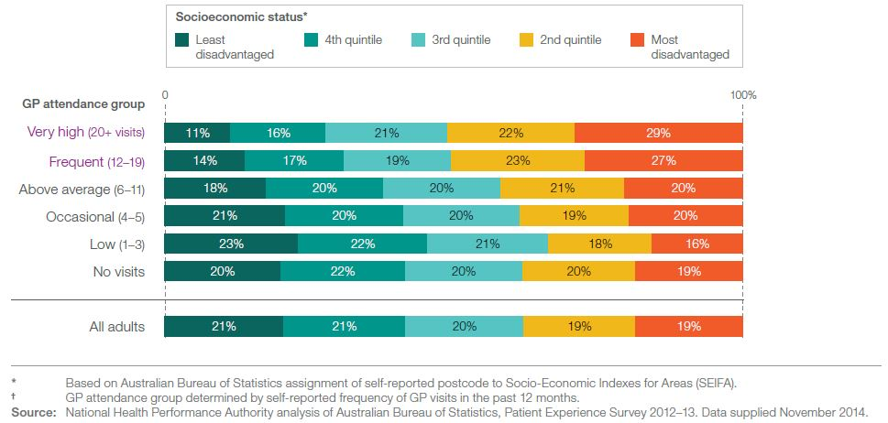
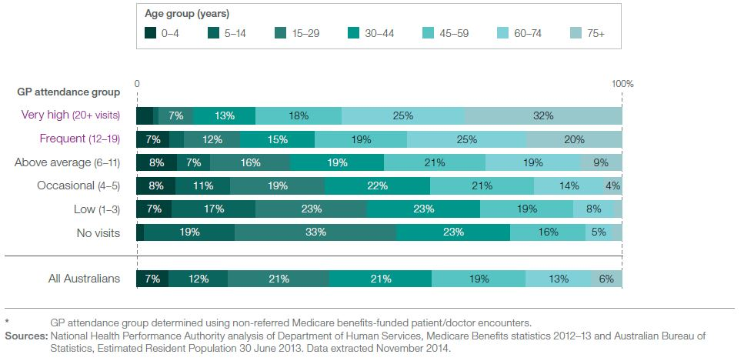
MBS CLAIMS GP ATTENDANCE 2012-2013
Marker of
Health Care Needs
Warranted Variation
Differences in
patients needs
Notes:
For example, in 2012-2013 Australians who were Very high and Frequent GP attenders (so people that Had more than 12 visits in a year) were more likely to be older and live in areas with the most socio-economic disadvantaged.

Slide 5
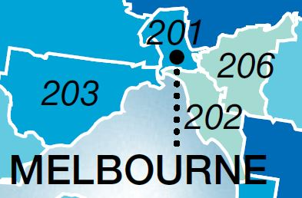
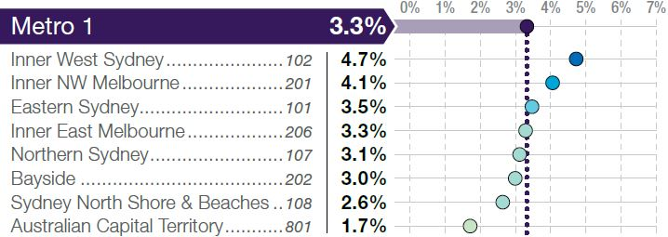
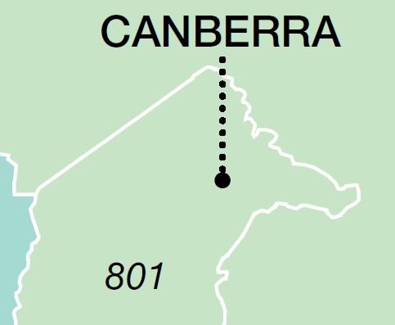
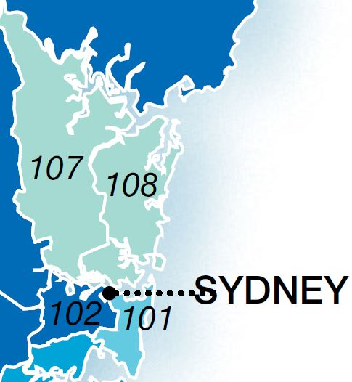
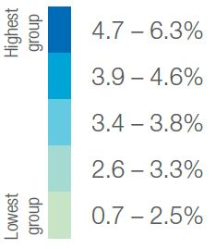
MBS CLAIMS GP ATTENDANCE 2012-2013
MEDICARE LOCAL METRO 1
Percentage of people who attended a GP 20 times or more in the year
Notes:
However, if we look at the Local variation among GP attenders across similar areas:
With similar age, education and income than you observe that some people have much higher utilization than some others.
Why the percentage of Very Frequent GP attenders is much higher in the area of Inner West Sydney compared to the area of Australian Capital Territory ?
For example people living in Sydney may have easier access to care or it may indicate that some people are having unnecessary and potentially harmful tests or treatments . So providers generate demand beyond what is clinically necessary.
So the complex question is why medical practice varies from place to place?
Which variations- or what proportion of variation- are good (or warranted) and which are bad (unwarranted) ?
Are the regions or practitioners with high rates over-providing, or are the low ones under-providing, or does the ‘best’ rate lie somewhere in the middle (or beyhond either end) ?
In order to answer at these questions and explain this variation, we have to select an appropriate geographic unit, such that spatial comparison are meaningful and interpretable.

Slide 6
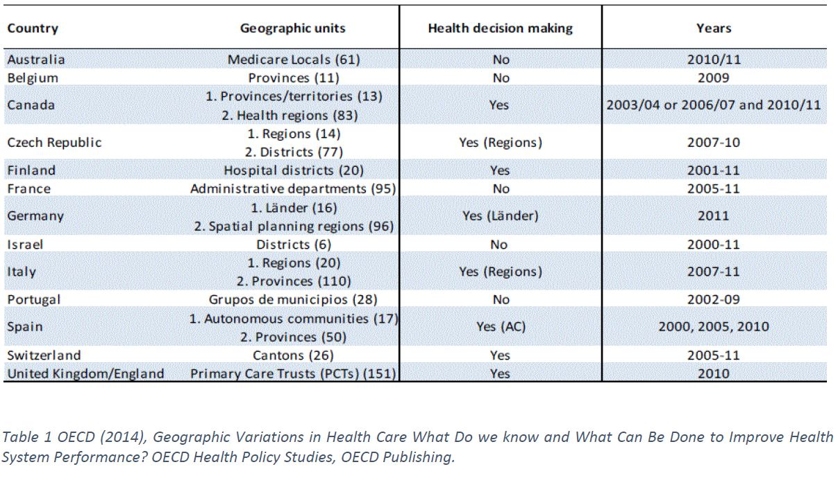
Geographic Variation
Geographic units
Notes:
The geographic unit used in Australia was the Medicare Locals.

Slide 7
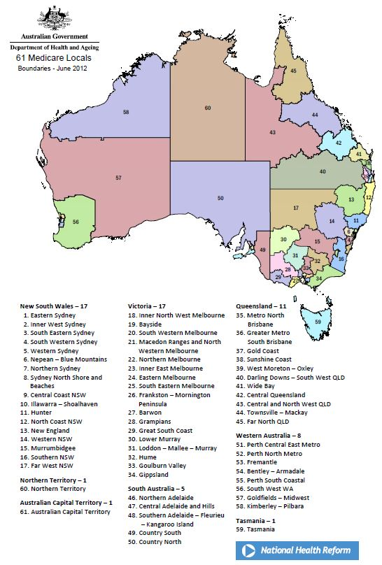
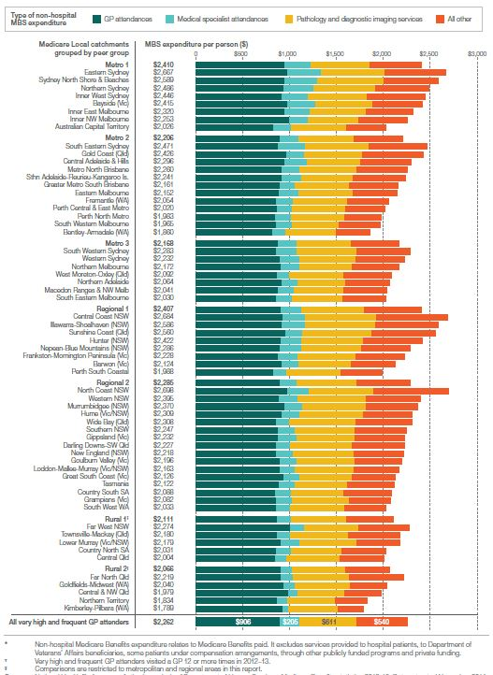
MEDICARE LOCAL CATCHMENT
1
2
3
4
5
6
800 000
7
40 000
Notes:
However these administrative boundaries suffer of a limitation:
They vary considerably in population size, health and socioeconomic status and geographic area. So the National Health Performance Authority have documented the variance between the 61 MLs of GP attendance and acute care by allocating each ML to one of seven peer groups.

Slide 8
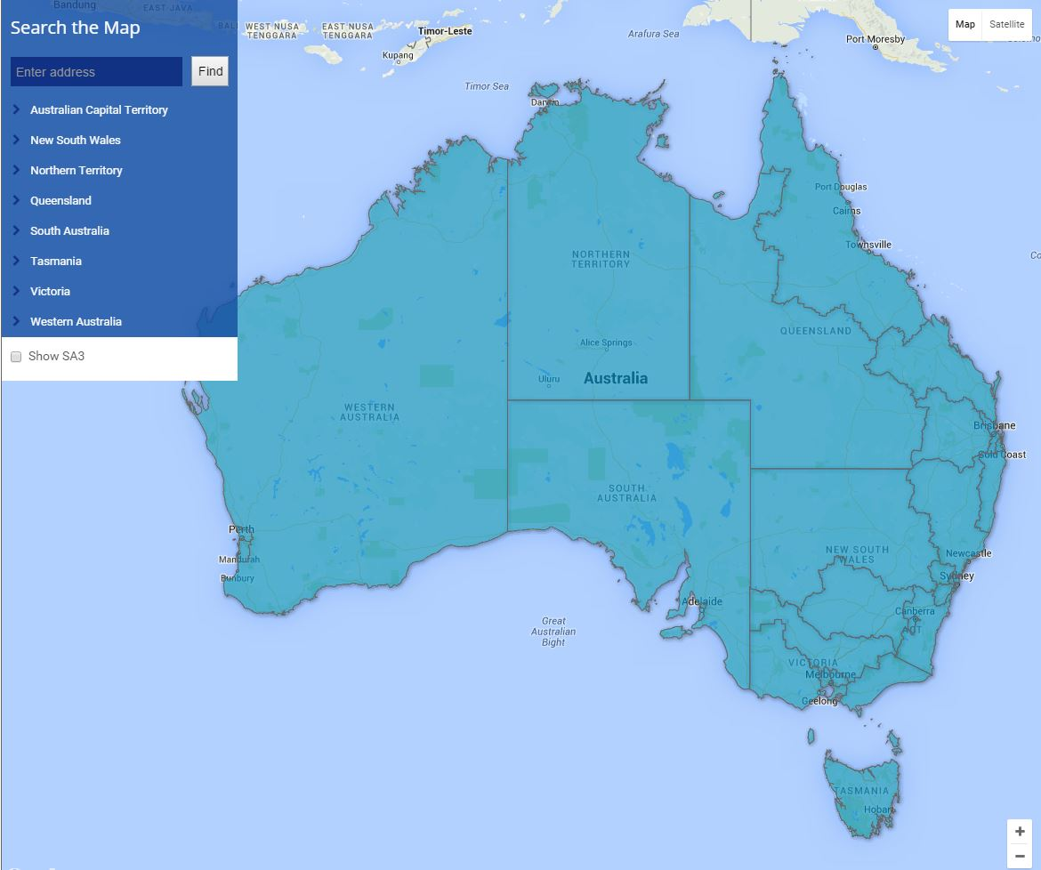
PRIMARY HEALTH NETWORK (PHN)
QUEENSLAND
17 – Brisbane North
18 – Brisbane South
19 – Western Sydney
20 – Nepean Blue Mountains
21 – South Western Sydney
22 – Central Queensland, Wide Bay,Sunshine Coast
23 – Northern Queensland
NORTHEN TERRITORY
30 - Northern Territory
30
23
New South Wales
28
21
22
17
1 – Central and Eastern Sydney
2 – Northern Sydney
3 – Western Sydney
4 – Nepean Blue Mountains
5 – South Western Sydney
6 – South Eastern NSW
7 – Western NSW
8 – Hunter New England and
Central Coast
9 – North Coast
10 – Murrumbidgee
WESTERN AUSTRALIA
18
20
19
26 – Perth North
27 – Perth South
28 – Country WA
25
9
26
7
8
27
4
3
SOUTH AUSTRALIA
24
10
31
5
2
1
Australian Capital
Territory
24 – Adelaide
25 – Country SA
15
6
16
12
11
14
VICTORIA
13
31 – Australian Capital Territory
11 – North Western Melbourne
12 – Eastern Melbourne
13 – South Eastern Melbourne
14 – Gippsland
15 – Murray
16 – Western Victoria
29
TASMANIA
29 – Tasmania
Notes:
However, from 1 July 2015 MLs have been replaced by a smaller number of Primary Health Network. The 31 PHNs areas are much larger in size and have greater diversity in their populations’ characteristics and have therefore not been grouped.

Slide 9
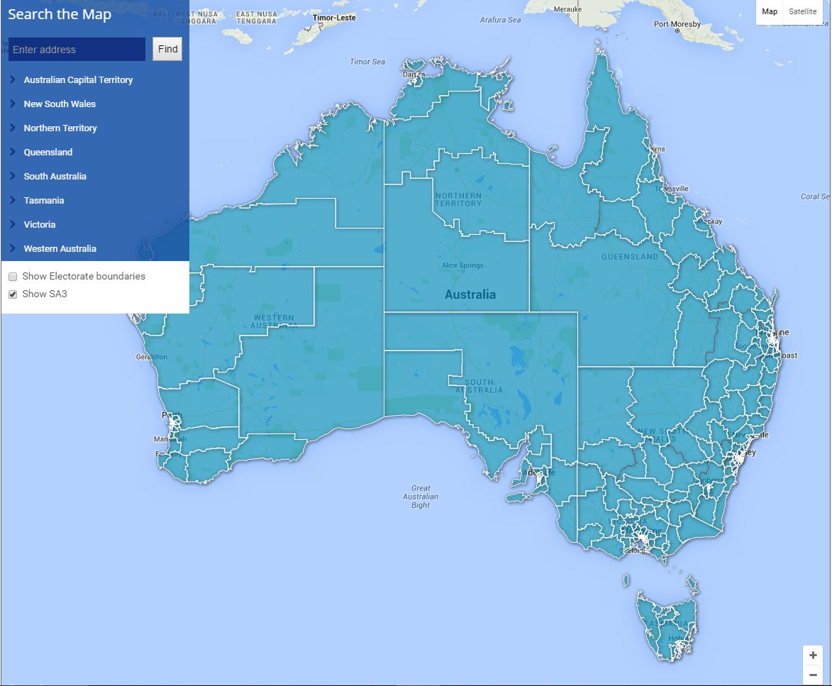
STATISTICAL LOCAL AREA LEVEL 3
SA3
Notes:
Instead the Authority reported the variation using smaller local areas (SA3).

Slide 10
RESEARCH CASE
What is a Catchment Area(CA) ?
Geographic area that contains
the bulk of population served.
What Properties Must satisfy ?
Preferences
Homogeneity
Stability
A
A
A
2014
2015
A
A
A
A
t
t
CUSTOMIZABLE
Indicator Type
GP Bulk Billing
After hours GP service utilization
GP service utilization by residents of Residential Age Care Facilities
Specialist service
Diagnostic and surgical procedures
…………
RATIONAL PRIMARY CARE SERVICE AREA RPCSA
Notes:
Anyway, it was soon realized that an alternative geographical unit should be selected for the study of the Geographic Variation. More precisely, the new geography should be able to incorporate people preferences toward provider location and must be homogenous along a number of dimensions so they allow meaningful geographical comparison. Another important property is that they have to be stable: small changes in the data should lead small changes in the definition of their boundaries, so the same set of areas can be meaningful used for a long period of time ( for example 5 years). The geographic areas will also be peer grouped for fair comparison.
But most importantly these geographies are Customizable: meaning that they depend on the specific indicator.
For example if you want to study variation in the number of GP visits it would make sense to group together people who tend to attend the same type of GPs. If you mix together people that go to different types of GP visits you may not find interesting variation in practice. So depending on the Research Question you may to ask you need to design different catchment areas. They are called catchment areas because usually you are looking at services. Catchment areas for GP services it means an area that catch most of the people that use the services in that area.
We named this new Generation of service areas: Rational Primary Care Service Area.

Slide 11
Outline
Motivation
Geographic Variation
Research Case
Australia – Medicare Local & Primary Health Network
Research Objectives
Literature Review
Access to Health Care
Limitations
Potential Accessibility Vs Revealed Accessibility
Research Methodology
PHN peer Grouping – RPCSA Design – Supply/Demand
Research Plan
Notes:
So what are the objective of this research ?

Slide 12
Objectives
How to study the geographic variation within and across PHN catchment
How to design catchment areas for Primary Care
How to estimate population catchments for Primary Care
PHN FRAMEWORK
RPCSA DESIGN
HW Supply/Demand Planning
Notes:
Basically this research has three important outcomes:
The first Two were commisioned by AIHW
The identification of appropriate Peer groups for the PHN in order to enable fairer comparison within and across these service areas.
Then how to design geographies optimally suited to study the geographic variation of Health related indicators.
And finally using this framework The Department of Health want to model multiple scenarios to determine the optimal location for health services, as well as the number of people served in each scenario.
A common denominator of these three objectives is a good understanding of Accessibility. How to model Access to Health Care Services.

Slide 13
Outline
Motivation
Geographic Variation
Research Case
Australia – Medicare Local & Primary Health Network
Research Objectives
Literature Review
Access to Health Care
Limitations
Potential Accessibility Vs Revealed Accessibility
Research Methodology
PHN peer Grouping – RPCSA Design – Supply/Demand
Research Plan
Notes:
So How can we model Access to Health Care Services ?

Slide 14
Access to Health Care
Notes:
As mentioned at the beginning a number of factors are known to increase the likelihood that people in certain areas will see a GP more often.
These includes
Non-spatial factor such as the Socio-economic and demographic composition of the population.
And Spatial factors: The Availability of health services in the area from the supply side, the number of people living in that area from the demand side.
And the travel time or distance between patient location and service points.

Slide 15
REVIEW OF ACCESSIBILITY
SPATIAL METHODOLOGIES
Gravity-Based (Joseph and Bantock 1982)
Regional availability model(Khan 1992)
Kernel density models(Silverman, Gugliardo 1986)
2 Step Floating Catchment Area (Rodke and Mu)
Enhanced 2SFCA (Luo and QUI)
Carr Hill (1994), Field(2000)
Principal Component Analysis (Mc Grail and Humphreys)
Factor Analysis (Wang Luo 2004)
Equity Model (Wang and Meng)
P
O
T
E
N
T
I
A
L
A
C
C
E
S
S
ASPATIAL METHODOLOGIES
SPATIAL & ASPATIAL METHODOLOGIES
Notes:
Usually the two types of factors are studied separately. (For example, Khan Bantock and Luo focused on spatial access to health care. Carr-hill and Field emphasized Non Spatial factors.)
There were few attemps to integrate the two categories variable,( using various technique such as the Principal Component Analysis, the Factor Analysis and The Equity Model). However, all the existing techniques don’t take into account the effective spatial interaction between patient and providers. Or what is usually called the Revealed access to Health Services. They only consider the Potential Access.

Slide 16
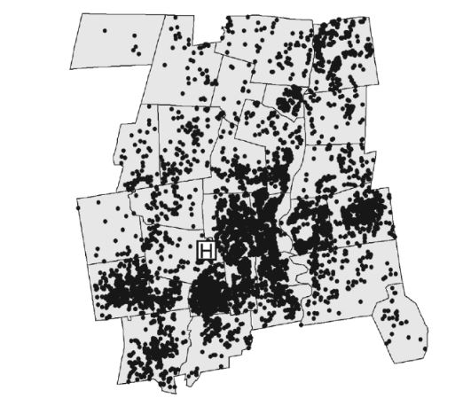
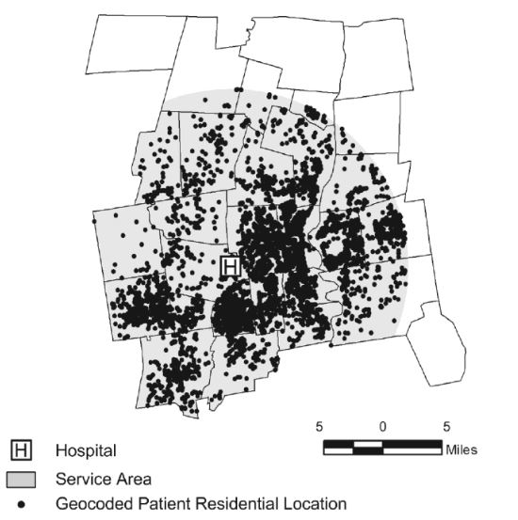
REVIEW OF ACCESSIBILITY
POTENTIAL ACCESS
80 %
H
H
Hospital Service Area Based on Geocoded Patient Residential Locations Excluding Outliers. Source: GIS and Public Health 2nd ed Ellen K. Cromely. Guilford Press 2012
H
Notes:
For Example, given the geocoded information of the patients we can plot the 80 or 90 % of clients who live closest to the facility and identify the Service Area. However, such patterns are not the results of individual choices about when and where to use services.
Therefore the main challenge of this research is to integrate spatial and non-spatial factors into one framework for Assessing Revealed Access to healthcare.

Slide 17
Outline
Motivation
Geographic Variation
Research Case
Australia – Medicare Local & Primary Health Network
Research Objectives
Literature Review
Access to Health Care
Limitations
Potential Accessibility Vs Revealed Accessibility
Research Methodology
PHN peer Grouping – RPCSA Design – Supply/Demand
Research Plan
Notes:
So let’s how we can actually do it !

Slide 18
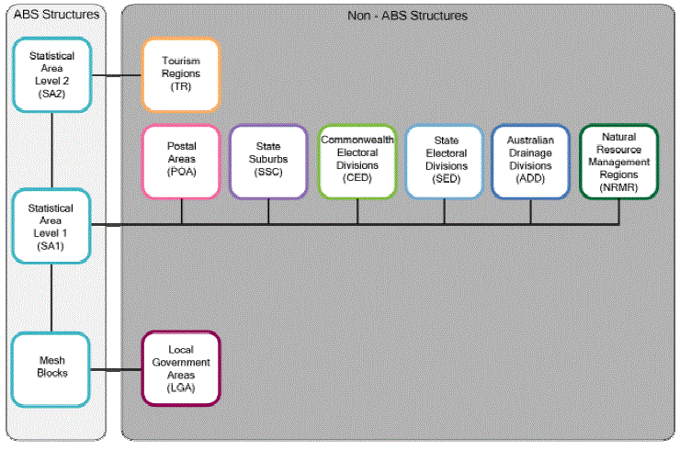
PHN FRAMEWORK
# 31
# 333
SA3
# 61
VARIABLES
1 -Infrastructure
NON ABS STRUCTURE
The smallest area for which MBS Claim data are available
# 2916
ARIA +
2011
2-Demographic
# 54.805
ERP = 0 # 1.188
ERP > 0 # 53.617
SEIFA -irsd
2011
ERP
2013
Notes:
The first step is to identify the relevant demographic, socio-economic and geographic attributes needed to evaluate the degree of homogeneity in a specific area. In this research we propose the following framework for reporting the PHNs Geographic Variation by SA3 level. This framework includes the Socio Economic Index for Australia and the Estimated Residential Population as non-spatial variables and the Accessibility Remoteness Index for Australia as spatial variable.

Slide 19
PHN FRAMEWORK
2
1
3
Notes:
More precisely for each SA3 we have as many records as the total number of smaller geographic units included in the Area (called SA1) and the attributes values. In this example the SA3 area includes 3 SA1s.

Slide 20
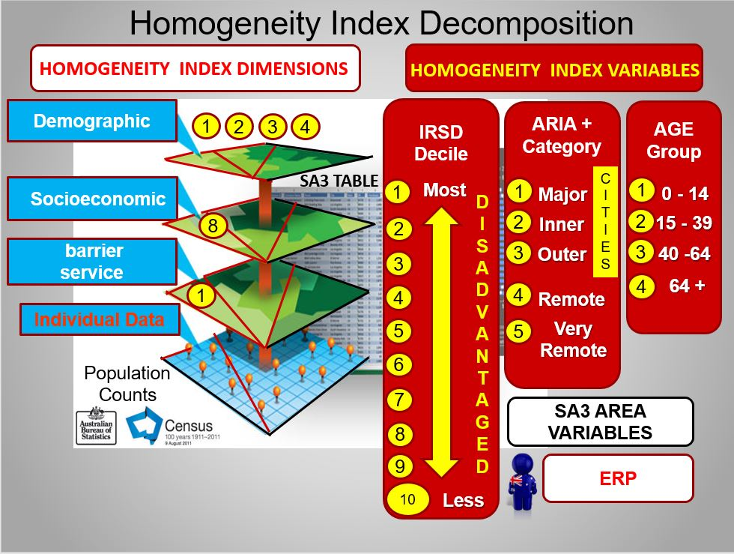
PHN FRAMEWORK
Notes:
For example this SA1 has 6 values: the Socio-economic classification, the Accessibility category and the number of residents for each age group.
Now the next stage is to define the concept of Homogeneity.

Slide 21
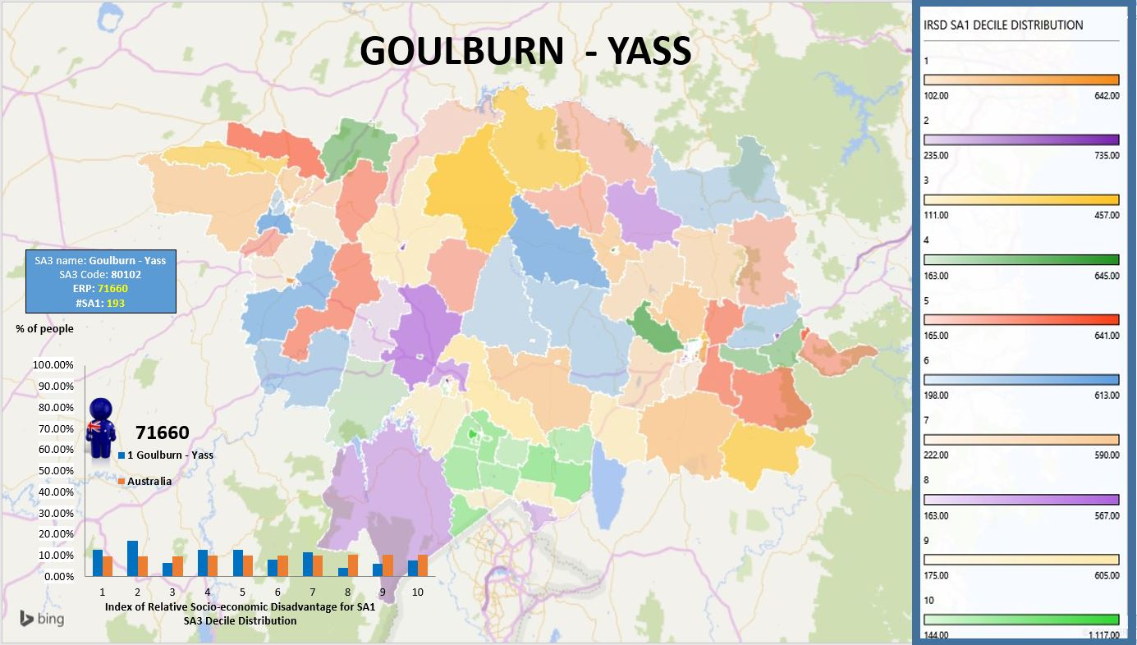
PHN FRAMEWORK
Notes:
For example, if we look at the area of Goulburn Yass, we observe that the socio-economic characteristics of the population are very different. The likelihood to find someone living in any of the decile section of the socio-economic index is more or less the same. We can see the Blue Histogram of Goulburn Yass on the left hand side. This means that the uniform distribution has the minimum homogeneity. Similarly, in the Case of Australia ( the orange histogram in the figure) has a flat distribution, so it is the most heterogeneous in terms of any combination of the variables under study. Conversely, when all the population is concentrated in a single socio-economic class we have the maximum homogeneity so the geography can be easily classified.

Slide 22
PHN FRAMEWORK
Notes:
On the basis of this principle we proposed a novel technique to define the Homogeneity Index of a Distribution. And we computed this Index for the SA3 geography classified the distributions in terms of the SEIFA decile (the small circle underneath the distribution) and we realized that nearly half of these geographic units cannot be easily classified. Therefore, the SA3 catchment is not an appropriate unit of analysis.

Slide 23
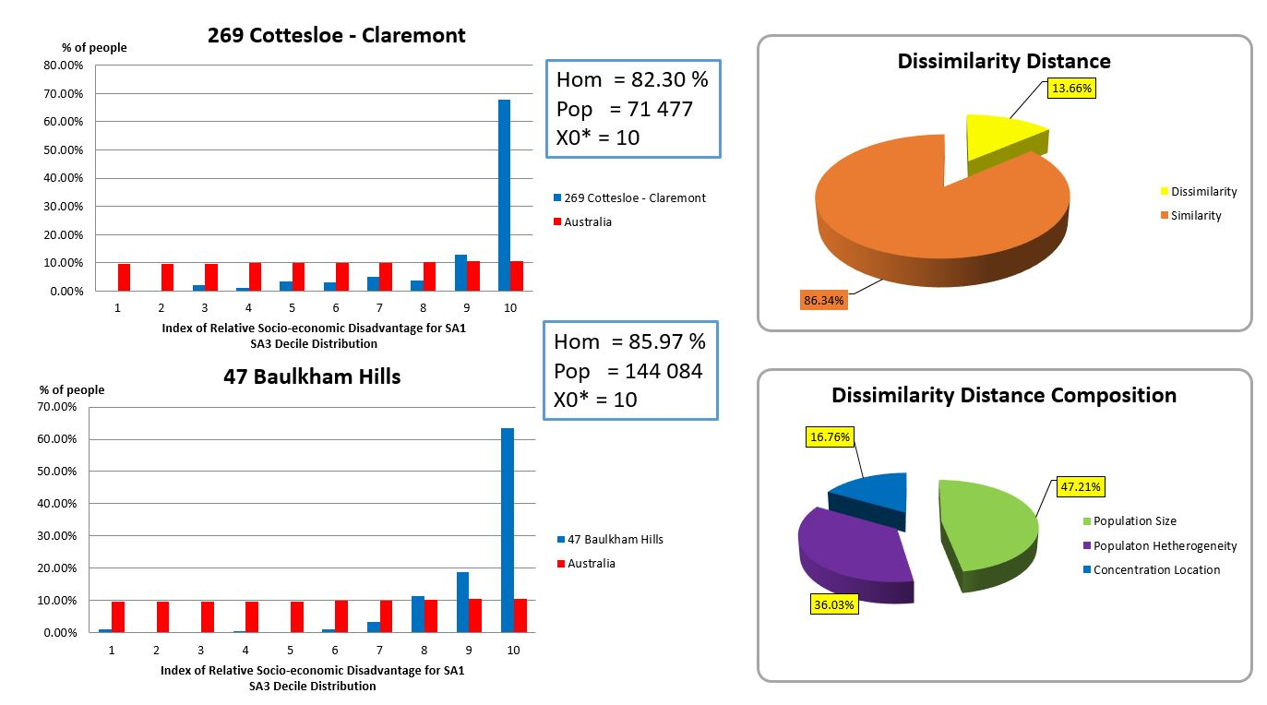
PHN FRAMEWORK
Notes:
Finally, in order to group similar geographies we designed a metric which tells us the degree of dissimilarity between any two SA3. In this example the two distribution look like very similar: they have similar shape and classification but slightly different population size.

Slide 24
Outline
Motivation
Geographic Variation
Research Case
Australia – Medicare Local & Primary Health Network
Research Objectives
Literature Review
Access to Health Care
Limitations
Potential Accessibility Vs Revealed Accessibility
Research Methodology
PHN peer Grouping – RPCSA Design – Supply/Demand
Research Plan
Notes:
Now that we know what Homogeneity means and how we can compare any two geographic areas, we should encode in the model the patients preferences about where to use services. The spatial interactions between patients and health providers can be explained using the definition of the Localization Index in the Design process.

Slide 25
RPCSA DESIGN
How to design Rational Primary Care Service Areas:
each catchment is a join of several Postal Areas (POAs).
Define a performance index to each possible design of catchment areas.
Pick the catchment design that has best performance index.
What goes into performance index?
Homogeneity index.
Localization index.
Contiguity.
Well rounded Shape (Compactness).
No Holes.
How to define homogeneity?
Account for SEIFA distribution (ABS).
Account for age/sex distribution (MBS claims).
How to define localization index?
Account for number of services: in a “good” catchment area there is a high number of people utilizing services in the same area.
Notes:
Basically the problem is to aggregate the patients’ postal areas into larger geographic clusters (zones or catchment areas) in a way that the latter are Homogeneous in terms of the Socio-economic distribution and patients’ Age/Sex distribution. Regarding the Localization Index ,the Residents within the catchment area mostly attend the services in that area. Additionally, the output zones must have a compact geometric shape close to a circle or square such that they have minimal travel times and it has to be possible to travel between two points in a zone without having to pass another zone (Contiguity).
This qualitative description is actually defined in terms of these properties Contiguity, Compactness and No holes.

Slide 26
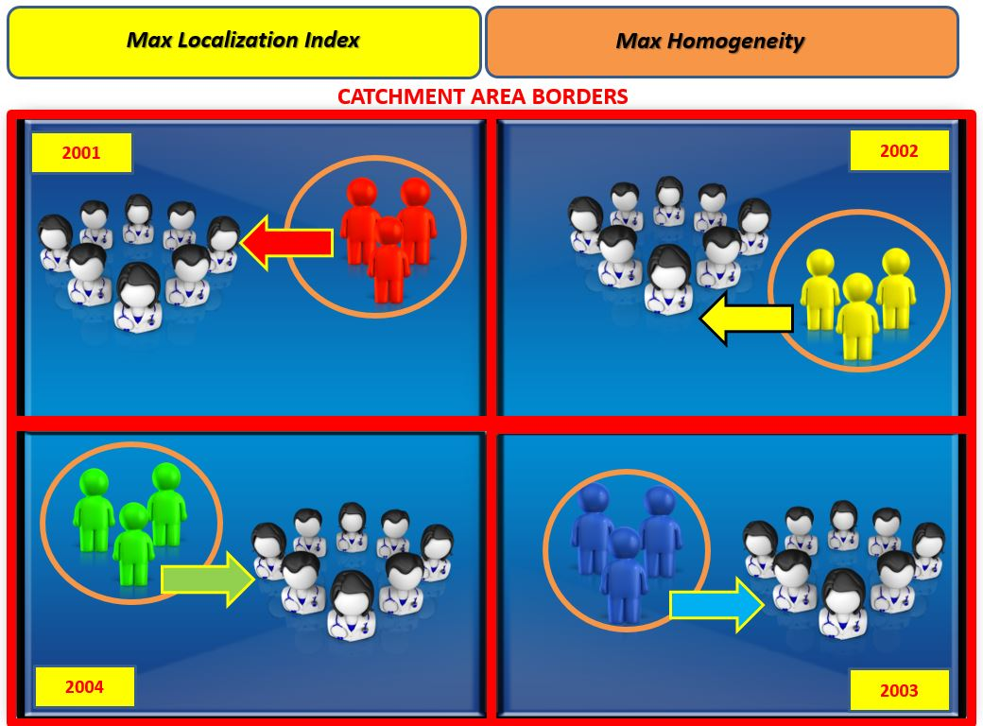
RPCSA DESIGN
Notes:
In this example, the whole area contains four POA. The POAs contain different groups of Medicare beneficiaries ( for example age group, socio-economic class or different combination of those variables) and providers who provided some Medicare service within a study period. Ideally, the population inside a POA obtains all of its primary care from clinicians within the POA.

Slide 27
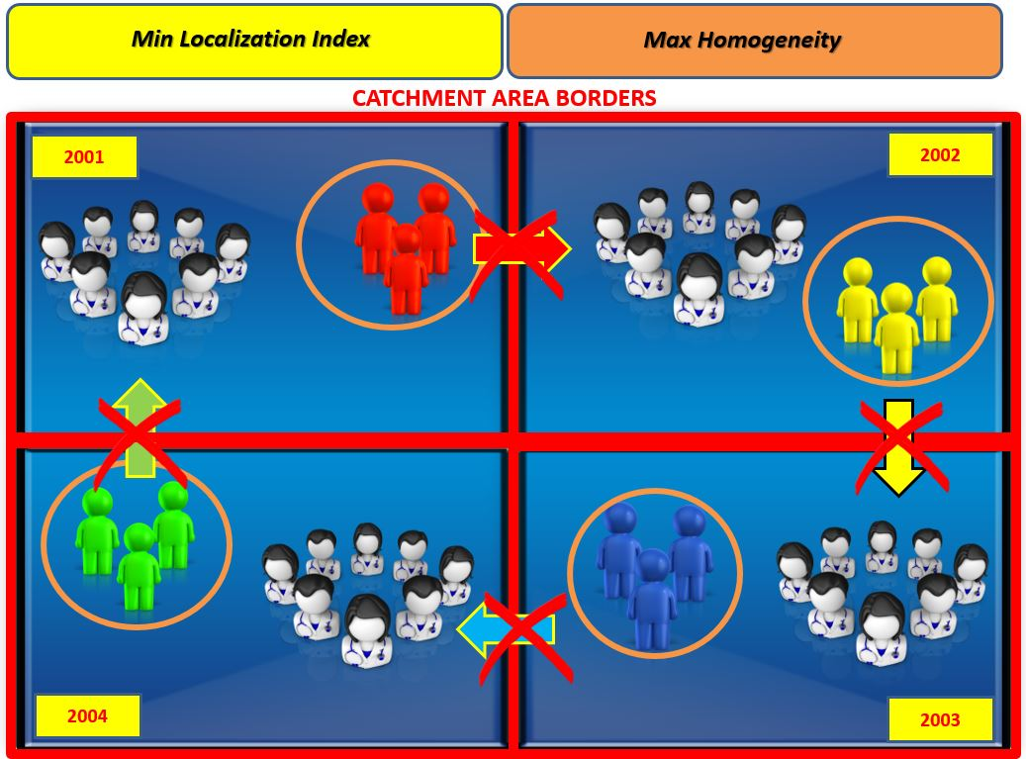
RPCSA DESIGN
Notes:
However, it is likely that most patients seek care in other areas and the overall demand ( represented by the arcs) within the catchment is uncover.

Slide 28
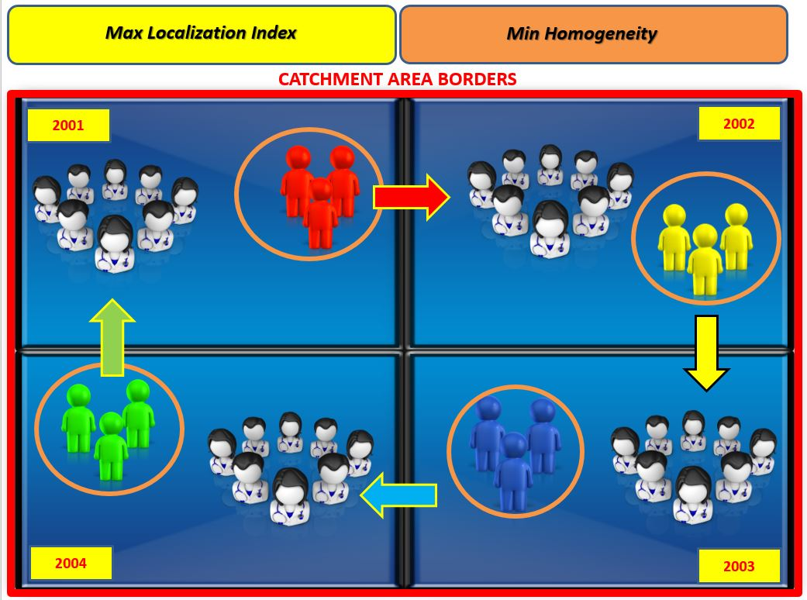
RPCSA DESIGN
Notes:
Conversely, if we select the whole area we maximize the number of people served within the catchment (max localization index) but we have a very heterogeneous population ( min Homogeneity Index).
In view of the previous example it’s quite natural to ask the following question:
How do we decide which is the best solution when we want to maximize two criteria that are clearly in conflict?
In this work the two competing objectives are engaged proposing a new multi-objective framework.

Slide 29
RPCSA DESIGN
RPCSA PROBLEM
Scale Effect
Scale
Problem
Uncertainty about the number of zones needed for a particular study
Variation in results when data for one set of basic spatial units are aggregated into fewer and larger units
Zoning Effect
Aggregation
Problem
Uncertainty about the number of zones needed for a particular study
Variation in results from the grouping of basic spatial units into larger units to form a given number of zones
Notes:
The framework involves the application of a model to a study area which has been partitioned into zones. The definition of these zonal boundaries involves the selection of the scale of the study (e.g. the number of POAs within a catchment area) and the aggregation of the data to match the choice of scale ( how to aggregate the POA to obtain a given number of catchment areas). The effects of these problems are known to researchers as the scale effect and the zoning effect.

Slide 30
RPCSA DESIGN
Notes:
This picture presents how the zoning and scale effects affect the Homogeneity and Localization Indices. In this example, the study area consists of 20 POAS and the aggregation occurs for 5,2 and 1 output zone. By aggregating the POAs into 5,2 or 1 output zone (the scale effect takes place) and both objectives go in opposite directions: the most aggregate level is the one that maximises the Localization Index but it is also the least Homogeneous.. Like the case of Australia is the most heterogeneous level.
Moreover, a critical issue with units of analysis is their population’s size heterogeneity; the greater the heterogeneity the greater the likelihood of observing extra-variation attributable to the population’s size rather than to variation in practice. Therefore the variation within the 5 output zones is smaller then the variation within the 2 output zones.
So in the Design process we should disaggregate a very heterogeneous population into very homogeneous sub-populations with a similar population size, while maximising the overall demand covered ( maximising the Localization index). This can be done only as a compromise: for example by imposing different thresholds for the mentioned objectives to control the scale and zoning effect.

Slide 31
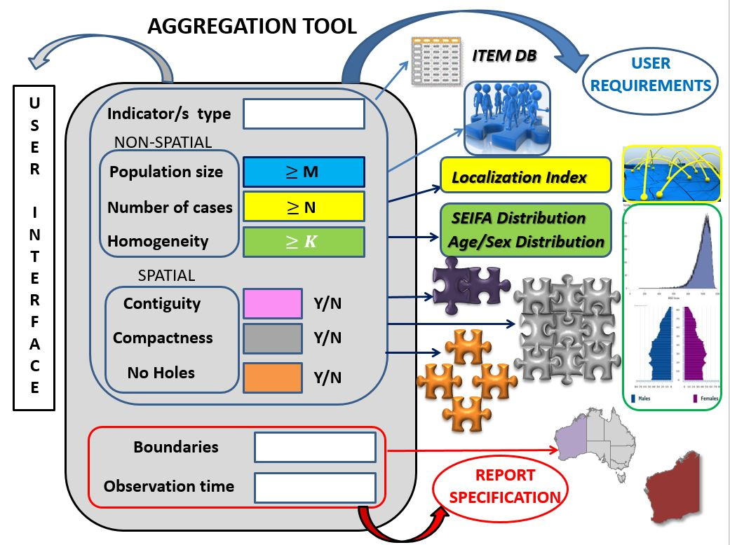
RPCSA DESIGN
Notes:
For example, in the aggregation tool we can specify the number of cases and the population included in the zone to control the scale and zoning effect. While the algorithm computes the best partition that maximise the homogeneity index with the aforementioned properties.

Slide 32
Outline
Motivation
Geographic Variation
Research Case
Australia – Medicare Local & Primary Health Network
Research Objectives
Literature Review
Access to Health Care
Limitations
Potential Accessibility Vs Revealed Accessibility
Research Methodology
PHN peer Grouping – RPCSA Design – Supply/Demand
Research Plan
Notes:
And Finally This framework is a valuable tool to identify areas with low supply of primary care. This is the last part of the project commissioned by the DOH.

Slide 33
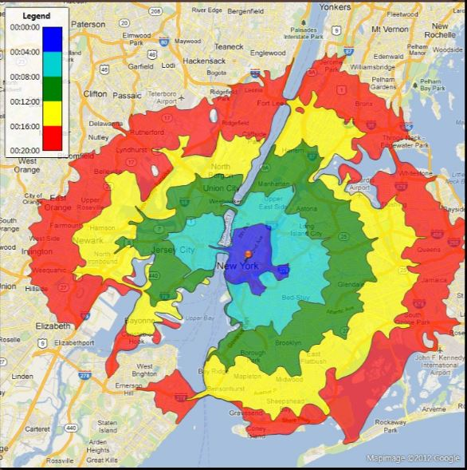
Provider
Distribution
Propose and
Evaluate
Alternatives
Health
Workforce
Supply/Demand
Decision
Maker
RPCSA
Model
Analysis
Spatial
DBMS
Spatial
Data Base
travel | Current | Expected
TIME | 16 min | 20 min
DISTANCE | 10 Km | 13 Km
Provider
Flow
ISOCHRONE MAP
Patient
PROVIDER
Age Sex Ethnicity
Australia/overseas trained
Limited registration
etc.
Notes:
More precisely, we will conduct a supply and demand study focusing on the GP Workforce initially, to analyse:
How long and far patients currently travel to access Primary Health Services.
What distance should patients be expected to travel given a specific distribution of providers.
Moreover, this research provides information about doctors and practice such as age/sex/ethnicity or whether trained in Australia or overseas and how these characteristics impact on distribution and serviced offered.

Slide 34
Outline
Motivation
Geographic Variation
Research Case
Australia – Medicare Local & Primary Health Network
Research Objectives
Literature Review
Access to Health Care
Limitations
Potential Accessibility Vs Revealed Accessibility
Research Methodology
PHN peer Grouping – RPCSA Design – Supply/Demand
Research
Architecture & Plan
Notes:
Although the main targets of this research are three. These components are embedded in a Complex Architecture of different stages and tool.

Slide 35
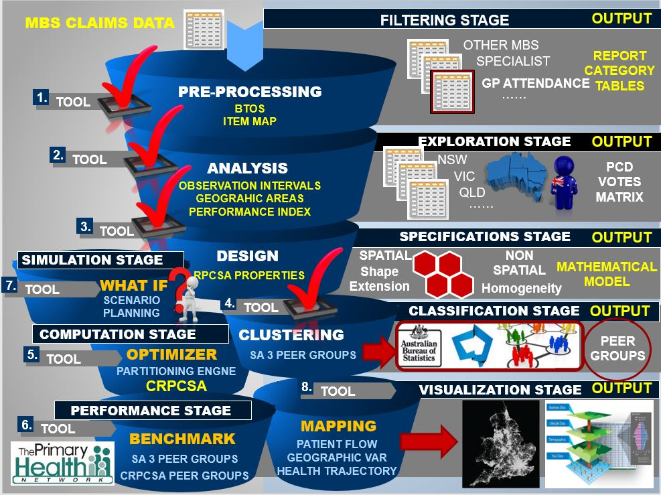
RESEARCH ARCHITECTURE
1
2
Notes:
The Architecture components can be easily described in two main processes of distinct stages. In the initial stage the data are filtered according to a specific category such as: GP or Specialist visits. Then the tables are sampled in one or more observation time frames for the selected geographic area. The final step in the Analysis process is to produce a votes matrix which summarizes people preferences to different locations, that contains all the information regarding the patient mobility within the study area.
The next stages are the core of the project . In the Design stage the user determines the relevant catchments’ properties, then the proposed model serves as a basis for the partitioning engine to produce Customizable Rational Primary Care Service Area. These geographies will also be peer grouped in order to compare the goodness in the benchmark module with other geographical units like SA3. Finally the integration of the zoning scheme output with the Simulation tool provides a framework suitable for the analysis of the key variables to identify the best health service allocation to increase the level of Accessibility.
All these tools are linked by several interfaces with a Graphical User interface useful to analyse the patient pattern behaviour and visualize the geographic variations in health care based on the patient’s place of residence.
The first three stages of the project have been accomplished and we are currently working on the final phase of the SA3 peer Grouping.
We have built the patient flows needed by the graph partitioning algorithm to produce the first set of RPCSAs. A mathematical formulation of the problem has been given although the user requirements should be clarified and documented to generate the corresponding specifications such as the number of cases and the population size..
Regarding the Peer grouping we proposed and implemented a method for comparing any two geographical areas in terms of Demographic, socio-economic and infrastructure variables. Additionally we developed an interface for displaying those variables and the diversity within and across geographical areas.
Therefore the next stages of this work are:
Finalizing the Peer Grouping Classification (End of August)
For the end of this year produce the first set of CRPCSA and compare the result with other geographies.
Then in the next academic year we will start the implementation of the simulation tool and the integration with a Visualization interface.
In the last year we planned to publish at least two papers on the Peer grouping methodology and the design of Rational Primary Care Service Areas.
A more detailed scheduled is reported in the COC document.

Slide 36
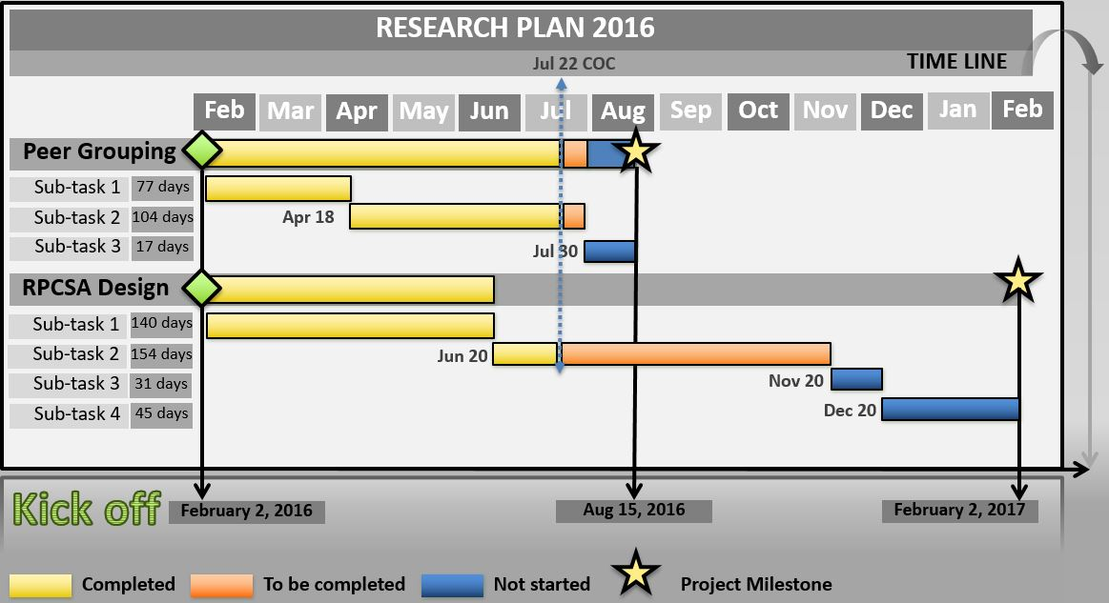
RESEARCH PLAN - 2016
Peer Grouping
Draft of proposed methodology for peer grouping geographic areas.
Apply peer grouping methodology to existing geographic areas reported by NHPA such as ABS SA3 for Primary Health Networks.
Produce a technical report on peer group methodology.
Notes:
Regarding the Peer grouping we proposed and implemented a method for comparing any two geographical areas in terms of Demographic, socio-economic and infrastructure variables. Additionally we developed an interface for displaying those variables and the diversity within and across geographical areas. And we planned to produce the first technical report on the Geographic Variation of PHN. Hopefully, I planned to Finalize the Peer Grouping Classification for the end of August.

Slide 37
RESEARCH PLAN - 2016
RPCSA Design
Draft of proposed methodology for RPCSA design.
Apply RPCSA design methodology to MBS data and produce a first set of RPCSAs.
Apply peer grouping methodology to the set of peer grouped RPCSAs.
Perform a series of comparisons between the conclusions drawn by studying geographic variation using RPCSAs and using other geographic boundaries, such as SA3.
Notes:
Concerning the Catchment Area Design:
We have built the patient flows needed by the graph partitioning algorithm to produce the first set of RPCSAs. A mathematical formulation of the problem has been given although the user requirements should be clarified and documented to generate the corresponding specifications such as the number of cases and the population size.. We planned to produce the first set of CRPCSA and compare the result with other geographies for the beginning of Febraury.

Slide 38
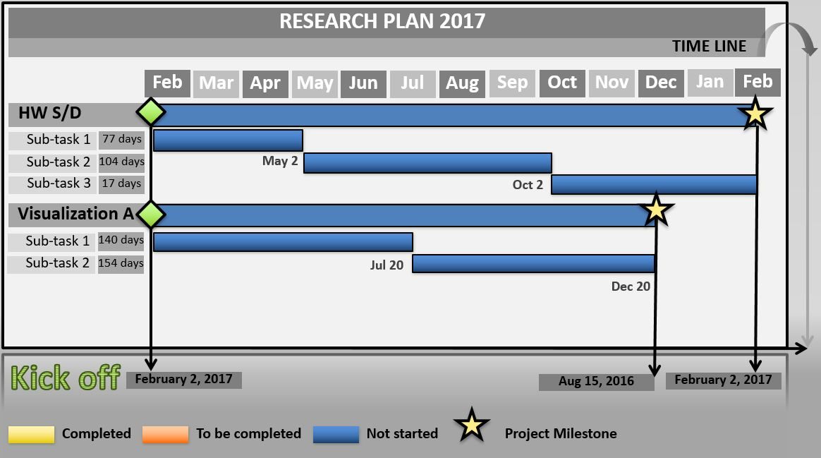
RESEARCH PLAN - 2017
Health Workforce Supply/Demand planning
Draft of proposed methodology for Health Workforce Supply/demand planning.
Apply the proposed methodology to design a simulation model and produce a set of RPCSAs based on the planning criteria.
Produce a technical report, focusing on
The current distribution of the medical workforce and patient access in Australia.
The findings of scenario analysis conducted using the tool model.
Options for strategic policy innovation that could support improved distribution of, and access to, medical services.
Notes:
Then in the next academic year we will start the implementation of the simulation tool and

Slide 39
RESEARCH PLAN - 2017
VISUALIZATION & ANALYSIS
Determine a methodology to analyse and visualize the patients flows (i.e. where people access what type of care).
Apply the proposed methodology to a set of RPCSAs to visualize flows based on the discovered regions and related attributes.
Notes:
And The visualization tool

Slide 40
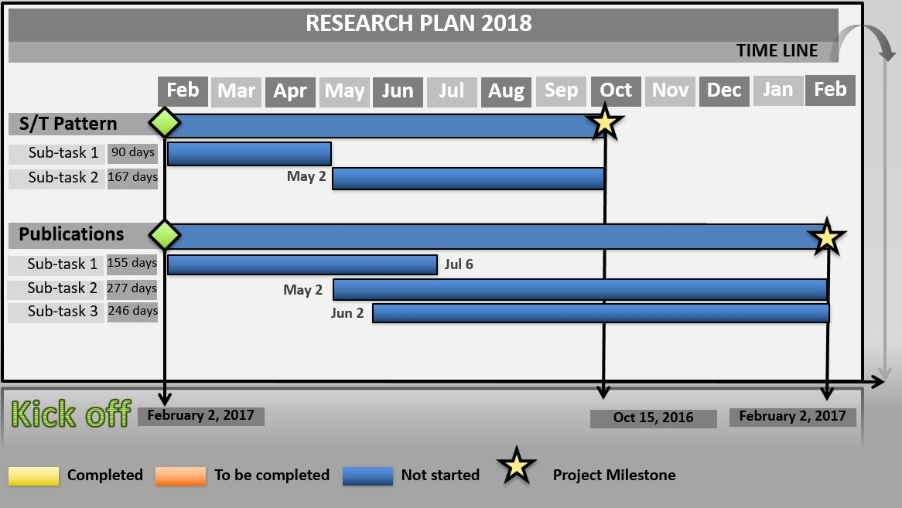
RESEARCH PLAN - 2018
SPATIAL AND TEMPORAL PATTERN ANALYSIS
Determine a methodology to analyse both geographic and temporal patterns of health care service use.
Apply the proposed methodology to MBS dataset in order to study patients’ trajectories through the entire health care system (when, how often and what type of care people seek).
PUBLICATIONS
Peer Grouping
RPCSA Design
Health Workforce Supply/Demand Planning
Notes:
In the last year I’ll deploy the application to study the spatial and temporal pattern of patient behavior in collaboration with Farshid. And I planned to publish three papers on the three topic of my research.

Slide 41
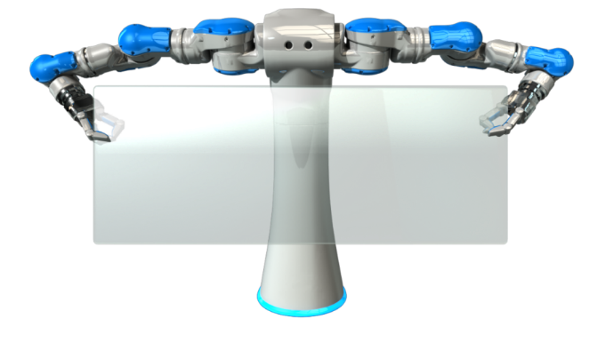
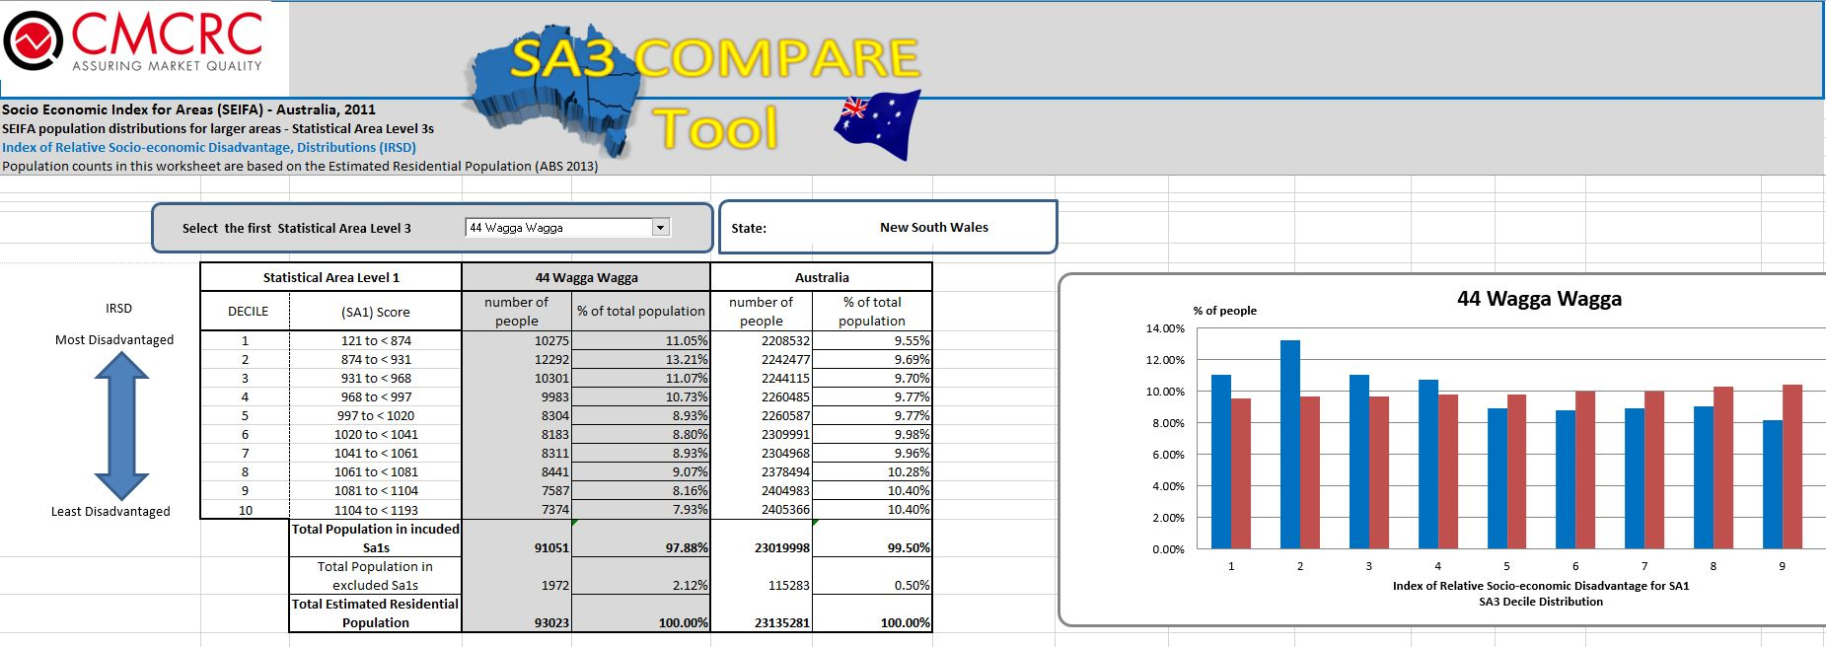
Questions?

