Slide 1
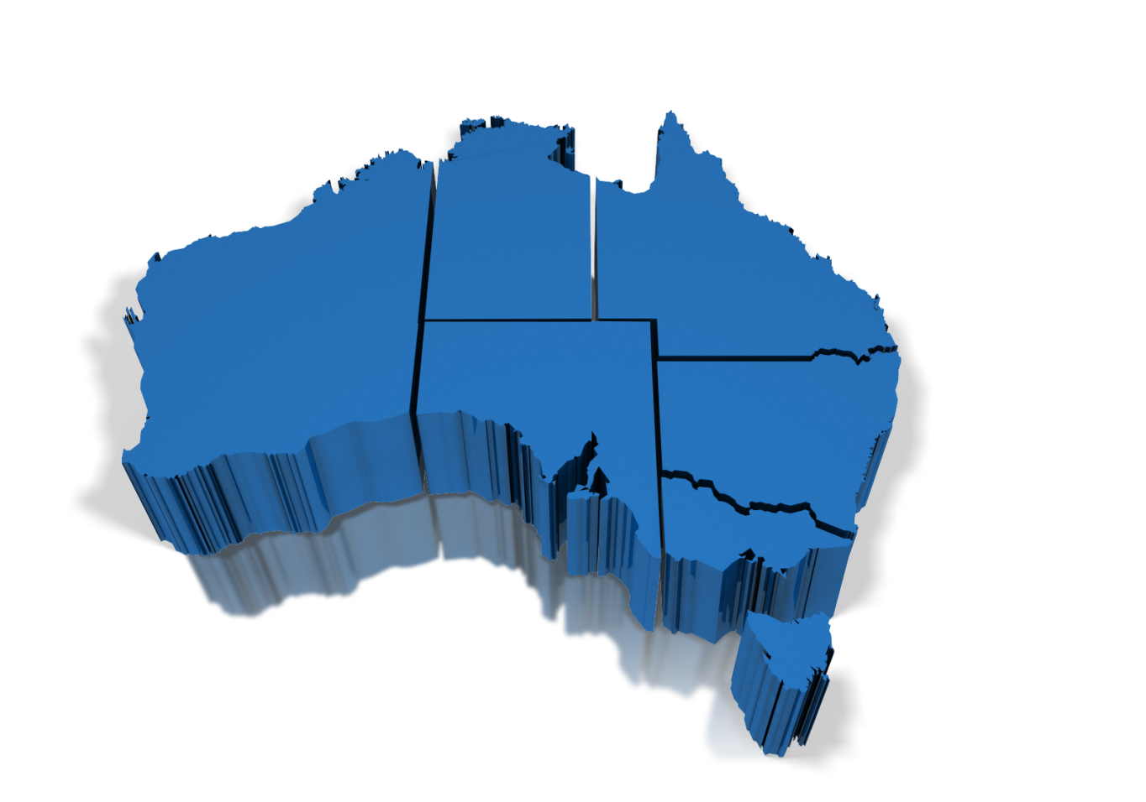
Development of Tools for the Analysis of Geographic Variation
and
Classification of Geographic
Peer Groups
PhD Student
Ludovico Pinzari
Academic Supervisor
A/Prof. Federico Girosi
AIHW supervisor
William Watson
Southern Sydney Local Health District
Soumya Mazumdar
Notes:
First of all, I’d like to welcome everyone and thank you very much for being here. I’m Ludovico Pinzari a PhD student of Western Sydney University and researcher at Capital Market CRC. Today I’m going to give you a brief overview of the project we have been working so far with the AIHW.
Basically, the problem that we want to solve is the identification and classification of areas suitable to study the geographic variation in health care delivery.
The scope is to develop tools and methods for use in reporting on the performance of primary helath care.

Slide 2
Outline
Geographic Variation in Health Care
Need to define appropriate geography for analysis
Need to define groups of geographies that are comparable to each other
MOTIVATION
BIG PROBLEM
SUB-PROBLEM: PEER GROUPING
Notes:
People want to study Geographic variation, in order to do that you need to define appropriate geographies
This is a Challenging problem that we do not discuss in detailed today, but once you have chosen a particular geography you still need to explain why it makes sense to compare geographies

Slide 3
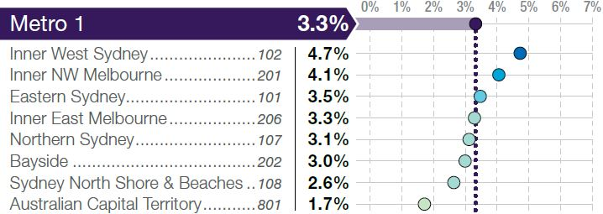
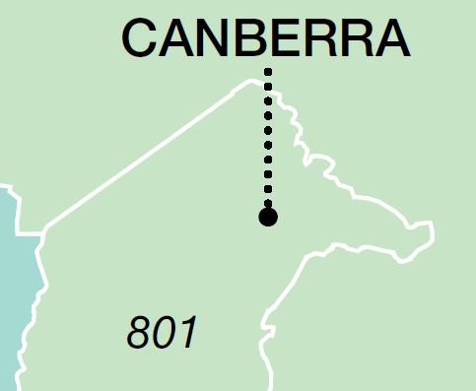
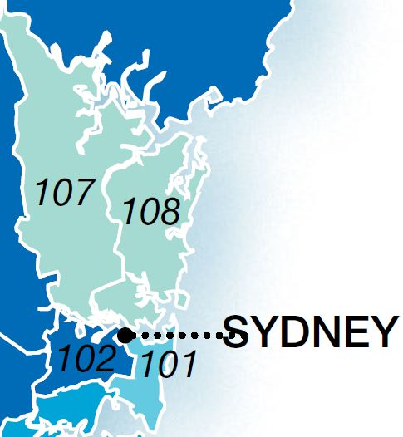
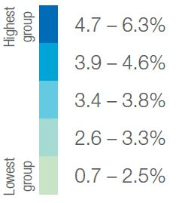
MBS CLAIMS GP ATTENDANCE 2012-2013
Example MEDICARE LOCAL METRO 1
Percentage of people who attended a GP 20 times or more in the year
what sense does it make to compare ACT with Inner West Sydney?
Notes:
For example, if we consider the Medicare Local and look at the Big variation among GP attenders between Western Sydney and Australian Capital Territory ..
You may probably asking yourself:
What does it mean ?
Are they even comparable ?

Slide 4
Are Medicare Locals a good geography for the analysis?
are Primary Health Networks a good geography for the analysis?
Notes:
However Medicare Local are gone and they have been replaced by a smaller number of Primary Health Networks.

Slide 5
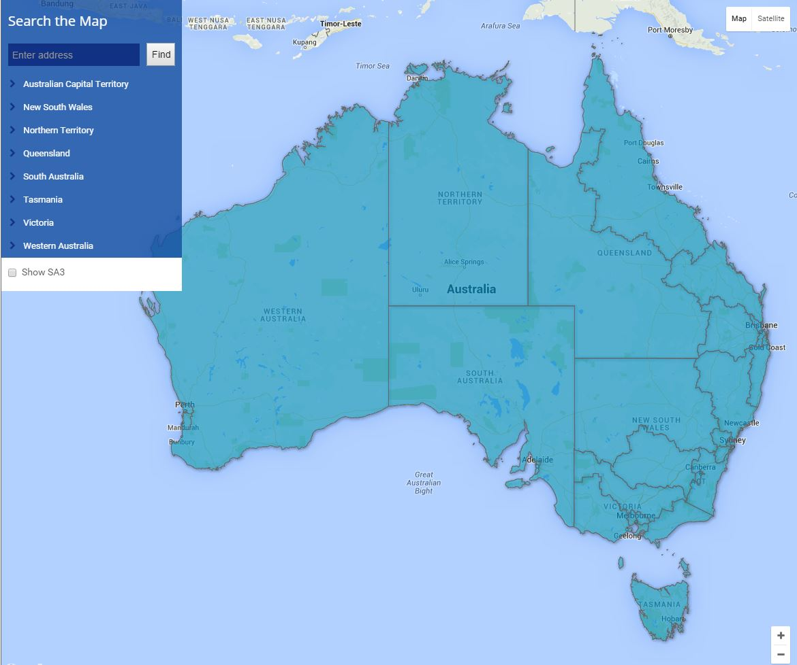
QUEENSLAND
PRIMARY HEALTH NETWORK (PHN)
31 #
17 – Brisbane North
18 – Brisbane South
19 – Gold Coast
20 – Darling Downs and West Moreton
21 – Western Queensland
22 – Central Queensland, Wide Bay , Sunshine Coast
23 – Northern Queensland
NORTHERN TERRITORY
30 - Northern Territory
30
23
New South Wales
28
21
22
PHN are too large!
1 – Central and Eastern Sydney
2 – Northern Sydney
3 – Western Sydney
4 – Nepean Blue Mountains
5 – South Western Sydney
6 – South Eastern NSW
7 – Western NSW
8 – Hunter New England and
Central Coast
9 – North Coast
10 – Murrumbidgee
WESTERN AUSTRALIA
17
20
18
26 – Perth North
27 – Perth South
28 – Country WA
19
25
9
26
7
8
27
4
3
2
24
5
SOUTH AUSTRALIA
10
31
1
Australian Capital
Territory
24 – Adelaide
25 – Country SA
15
6
16
12
11
14
VICTORIA
13
31 – Australian Capital Territory
11 – North Western Melbourne
12 – Eastern Melbourne
13 – South Eastern Melbourne
14 – Gippsland
15 – Murray
16 – Western Victoria
29
TASMANIA
29 – Tasmania
Notes:
The 31 PHNs areas are much larger in size and have greater diversity in their populations’ characteristics, socioeconomic status and geographic area.

Slide 6
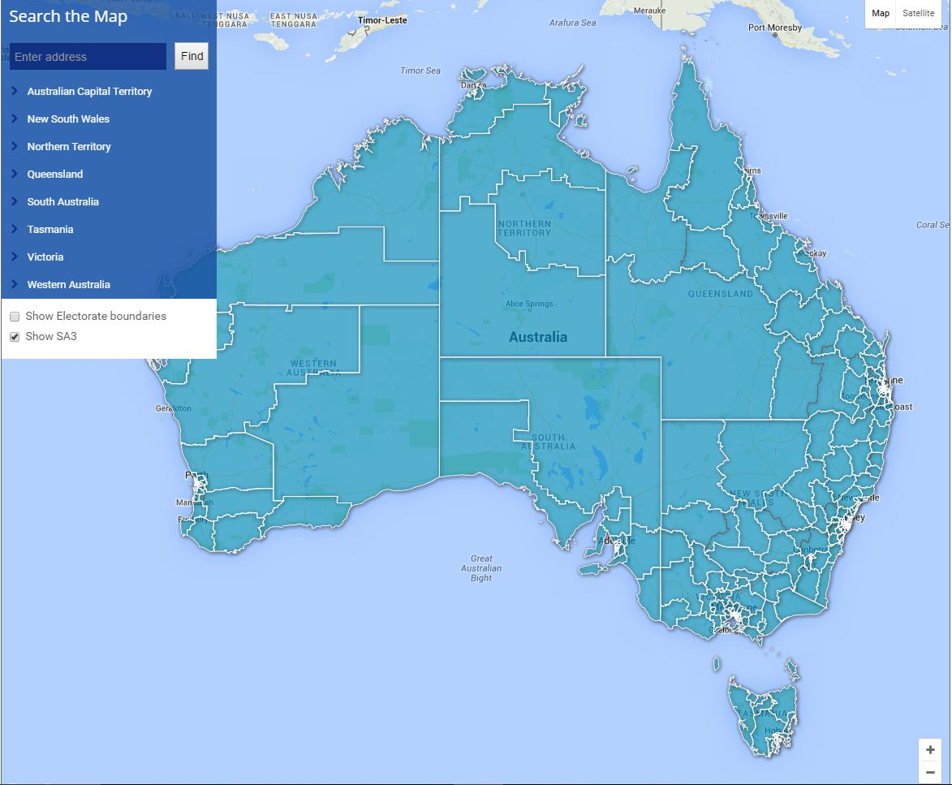
PHN 31 #
|
ABS Geography
SA4 106 #
|
SA3 333 #
|
SA2 2,214 #
|
SA1 54,805 #
333SA3
SA3 are more reasonable ...
Notes:
So we decided to look at a smaller geographic unit called Statistical local area Level 3 (SA3) that is an intermediate level in the ABS geography.

Slide 7
Which SA3 can be compared with which ?
How do we define similarity between two SA3s ?
Similarity concept must include:
Age/gender distribution
SEIFA socioeconomic distribution
Population size
ARIA+ remoteness distribution
Notes:
But what does it mean that two SA3 are similar and comparable ?
How do we define the notion of similarity?
But above all: is the SA3 an appropriate geography or not?
Clearly, the answer depends on the variables we want to analyze.
The basic indicators are the demographic composition of the population such as Age and gender.
the socio-economic status such as the SEIFA
The number of people living in that area.
And Finally the remoteness distribution: How much distance, cost, time and effort are involved in reaching the service facilities.

Slide 8
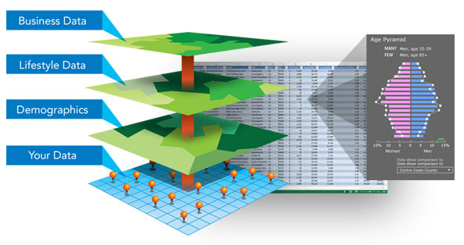
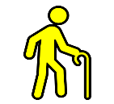
SA3 – FEATURES DIMENSIONS
SA3 VARIABLES
Demographic
Age
Group
0 - 14
15 - 39
40 -64
64 +
1
2
3
4
Socioeconomic
SEIFA DECILE
SEIFA – DECILE CATEGORY
Remoteness ARIA+
1 | 2 | 3 | 4 | 5 | 6 | 7 | 8 | 9 | 10
Individual Data
MOST
DISADVANTAGED
LEAST
ARIA+ – CLASSIFICATION
Population
Counts
B
A
C
SA1
1 | Major cities
2 | Inner Regional
3 | Outer Regional
4 | Remote
5 | Very remote
SA3 AREA
Notes:
For instance this picture shows how the system collects the information about the area of a generic SA3. In this example, the SA3’s area is partitioned in three smaller geographic units called SA1 (labelled A,B,C).
Each Sa1 is then linked to a thematic map that contains the information of a particular variable.
For example the number of people for each age group
The socioeconomic category and finally the remoteness classification.

Slide 9
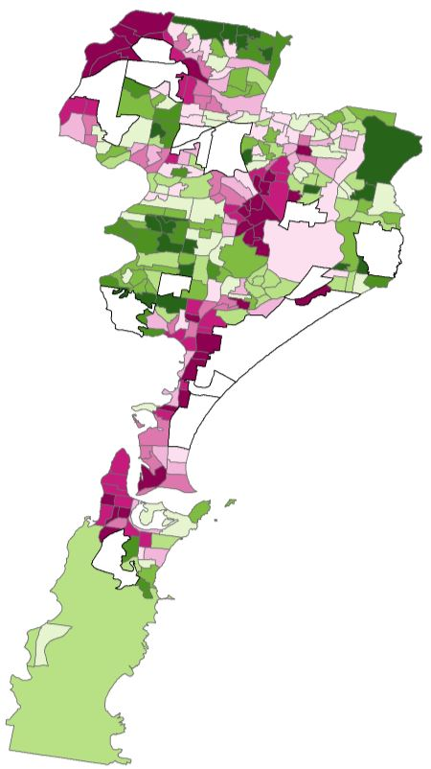
SA3 – FEATURES DIMENSIONS
SA3 VARIABLES
Demographic
1 | 2 | 3 | 4 | 5 | 6 | 7 | 8 | 9 | 10
Age
Group
A
AGE ERP
0 – 14 0
15 -39 10
40 -64 15
65 up 0
A
Socioeconomic
SEIFA DECILE
A
Remoteness ARIA+
A
A
Individual Data
Population
Counts
1 | Major cities
2 | Inner Regional
3 | Outer Regional
4 | Remote
5 | Very remote
A
303#
SA1s
SA1 within SA3 are usually between
50 - 350
Notes:
In this case the SA1 label A has 6 values. The socio-economic decile, the population for 4 different age groups and the remoteness classification. However an SA3 has more than a single Sa1, usually the number is between 50 – 350.
So to reduce this complexity we need a methodology to analyse and compare any two SA3.
The reasoning behind the development of such a method is that once the effects of the various demographic and geographic variables known to influence health have been removed, it is possible to compare similar regions by measures of health status.
However, in this presentation I’ll talk only about SEIFA but the methodology can be applied to any set of variables.

Slide 10
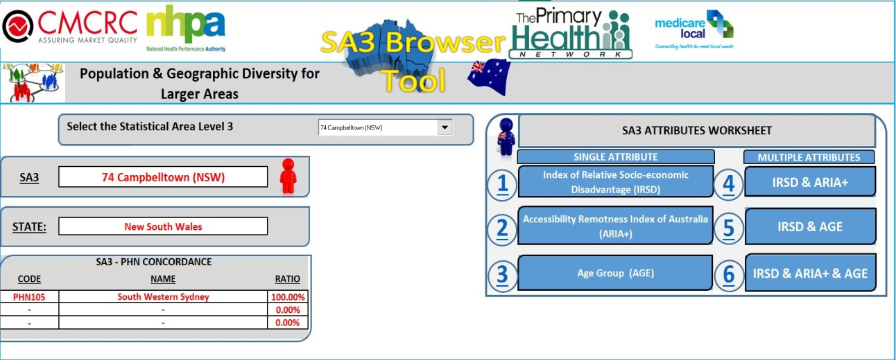
We developed an Index (Homogeneity) to:
Analyze the Diversity of a Geographic Area.
We built a TOOL that allows to:
Browse and Compare SA3, to understand how similar they are.
Clusters the SA3s in meaningful, comparable groups
The Drop Down Menu to Select the Statistical Area Level 3
Attributes Menu
Analysis of
Demographic & Geographic variables
Information related to the selected SA3 geography
Notes:
Therefore, AIHW requested that CRC explore possible ways of identifying comparable SA3.
In order to achieve this result we developed an Index to analyze the Diversity of a Geographic Area.
But above all, Today, we are proud to introduce you The SA3 Browser: The first Toll able to compare any two geographic areas and cluster them .. That is to divide a set of geographies into groups with similar characteristics. Namely peer groups.
But before describing the capabilities of this tool We still need to understand what homogeneity actually means

Slide 11
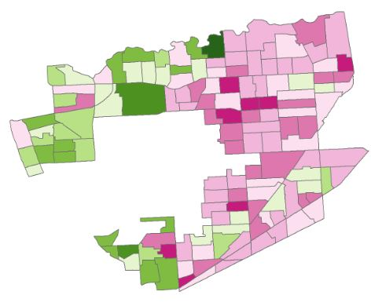
HOMOGENEITY INDEX
Lake Macquarie – East (NSW)
West Torrens (SA)
ARE THEY REALLY SIMILAR ?
SA3 - SCORE
SA3 - RANK
SA3 - DECILE
SEIFA INDEX – SA1 DECILE DISTRIBUTION
1 | 2 | 3 | 4 | 5 | 6 | 7 | 8 | 9 | 10
LEAST
DISADVANTAGED
MOST
DISADVANTAGED
Notes:
For example if we want to compare these two SA3s in terms of the Socio-economic index. By looking at these maps, where the purple colour represents the areas with the most disadvantaged conditions whereas the dark green depicts the wealthy ones, can we tell if Lake Macquarie is similar to West Torrens?
A common approach is to create a score from the population weighted average of the areas scores within the larger area. And we can see that the computed values are not so different.
Does it make sense?
Are they really similar?

Slide 12
751
75 %
ERP
123,976
Less Homogeneous
1075
# SA1
303
How do we define the Homogeneity of a distribution ?
950
75 %
ERP
61,241
More Homogeneous
1050
# SA1
143
Notes:
If we look at the Lake Macquarie distribution , approximately 75% of the population live in areas with a score between 751 and 1075. On the other hand the chart of West Torrens shows that the same percentage is concentrated in a smaller range indicating that the Homogeneity of this SA3 should be greater compared to the other one.
This means that information on distribution provides additional insights on the diversity of a geographic area.
But How do we define the Homogeneity of a distribution ?

Slide 13
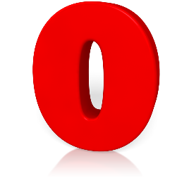
HOMOGENEITY INDEX
100 %
Generalization Gini Index
H
O
M
O
G
E
N
E
I
T
Y
GINI INDEX
88.89 %
Ordinal variable Dependent
89.64 %
Outline larger classes of distribution
63.62 %
Extended to more variables
Decomposable
0 %
...
Notes:
I’m not going too much into the details but basically is a generalization of the Gini Index.
Like the Gini Index is a number between Zero and One.
- One denotes complete Homogeneity (for, example in the SEIFA decile distributions all cases falling in the same category)
- Whereas it is zero when there is a uniform distribution of cases across all categories.
However, this index solves typical drawbacks of Gini’s Index:
For example, if we look at the Seifa deciles distributions in the middle they have the same set of probabilities. The population is evenly distributed in the middle deciles or in the first and last deciles. So if we compute the Gini’s we get the same value although the one below is more dispersed.
On the other hand, the Homogeneity takes into account not only the probabilities concentration but also the variance of the distribution.
In other words this index considers the order of the variables. This special property allows to classify a larger classes of distribution.
Moreover, the definition can be extended to more variables simultaneously and decompose the individual contribution of the variables. I’ve indicated just the main differences but we proved many other properties and compared these results to other indices in the working paper.
However a single value is not enough to describe the entire data set’s of values in a distribution.
Therefore, we defined a function: The Location Index

Slide 14
SEIFA DECILE
LOCATION INDEX (LI)
Generalization Median
60 %
?
Resistant to outlier
3.57
MEAN
Simple interpretation – middle value
1
1 2 3 4 5 6 7 8 9 10
3
4
LI
Innovation
Minimize Deviation of the scores from the location center
Algebraic form
Easier to calculate
Extended to more variables
8
LI
Notes:
In the case of the SEIFA decile distribution this index assumes a value between one (the most disadvantaged area) and 10 ( the least disadvantaged)
Basically is an equivalent form of the median:
Like the median is not influenced by outliers. For example, this SA3 has a mean around the fourth and third decile and Location Index in the first decile. Clearly the first decile is more representative since it contains more than 60 % of the population. Moreover, computing fractional values for categorical variables is not very meaningful.
Then, it is Easy to understand. It is The middle value of the distribution.
For example, in the Seifa decile distribution of this SA3 there is a predominant peak in the last decile but there are also high concentrations of values near the eight decile. So the LI identifies the position of the bin where the values in the surrounding area are noticeably higher than others.
But, What is the main difference compare to the median?
The definition is based on an algebraic form, so it is easier to calculate and can be easily extended to more variables. In the working paper we have done several comparisons with the mean, mode and seifa score decile and we proved that this index minimizes the absolute deviation of the scores from the Location center and therefore more appropriate to describe skewed and asymmetric distribution typical shapes of the Homogeneous SA3s.
But what makes the combination of the Location and Homogeneity Index a good descriptive statistic to classify a geographic area?

Slide 15
HOMOGENEITY DECOMPOSITION OF SEIFA DECILE DISTRIBUTION
EASY TO CLASSIFY
INTERMEDIATE
DIFFICULT
HARD TO CLASSIFY
Lord Howe Island
Brimbank
Alice Springs
SA3
100.00 %
54.80 %
31.98 %
Wagga Wagga
6
?
8.6 %
2
5
?
5
Tuggeranong
Daly-Tiwi-West
50.28 %
89.66 %
8
Lake Macquarie East
1
8.5 %
?
6
Ku-ring-gai
91.78 %
10
58.91 % of SA3 have
H $≤46.62 \%$
21.15 % of SA3 have
H $≥68.53 \%$
HOMOGENEOUS
HETEROGENEOUS
HOMOGENEOUS
H
NOT HOMOGENEOUS
Notes:
For example, by looking at the Homogeneity index of these SA3s we can immediately see that the ones on the left are more homogeneous compared to the ones on the right.
However, using the homogeneity index in isolation will not give a complete picture. So to better classify the geographic area, we calculated the Location Index.
But does it really make sense to compute this value for the heterogeneous group?
If we look at the shape of these distributions it is hard to give an answer!
On the other hand, this value is more representative for the Homogeneous SA3s.
So we computed the Homogeneity of the SA3s SEIFA variable, and proved some sufficient conditions to accept or not a geographic region, in order to make them suitable for the analysis. And it turned out that more than 50% of these regions cannot be easily classified and only 21 % can be considered reasonably homogeneous, therefore a reassignment of the smaller geographic units is needed to improve the homogeneity degree in the study area so they are not an appropriate geography for the SEIFA.
Now that we know how to classify a geographic area, we may want to know how to compare SA3s..

Slide 16
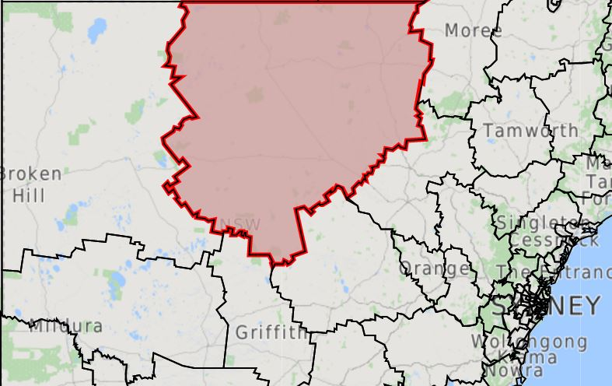
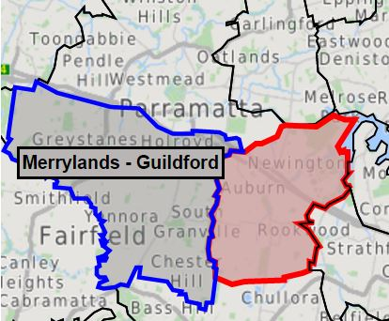
DISSIMILARITY DISTANCE
DISTRIBUTION
L1 DISTANCE
Far West and Orana
SA3 | Bourke Cobar Coonamble | Merrylands Guildford
Auburn | 16.75 | 17.40
 | Bourke Cobar Coonamble | 16.92
Bourke- Cobar- Coonamble
v
v
v
v
v
v
v
v
v
Parramatta
Merrylands - Guildford
Auburn
Notes:
A possible solution would be to define a distance which tells us the degree of dissimilarity between any two SA3s.
A basic approach is to compare the distributions of the SA3s SEIFA.
For example, assume we want to compare the SA3s in the area of Paramatta to the SA3 in the area of Far West, just by looking at the Seifa decile distributions, then they look quite similar to each other. So if we compare the individual bins distributions with the classical L1 distance we would probably say that they belong to the same group.
Moreover, it seems that Auburn and Bourke are the most similar.
However, if we are interested in the comparison of indicators across regions with similar population it is not probably the best idea.

Slide 17
DISSIMILARITY DISTANCE
POPULATION
CANBERRA DISTANCE
Far West and Orana
SA3 | Bourke Cobar Coonamble | Merrylands Guildford
Auburn | 54.63 | 34.75
 | Bourke Cobar Coonamble | 69.40
Bourke- Cobar- Coonamble
147,985
Parramatta
Merrylands - Guildford
26,541
Auburn
82,326
Notes:
On the other hand, if we look at the total population in each SA3 and compare the number of people in each deciles we get completely different results
And It is not difficult to see that Auburn and Merryland have similar population compared to Bourke and therefore they are in a different group.
However, comparing the Sa3s just by looking at the individual bins is not enough.

Slide 18
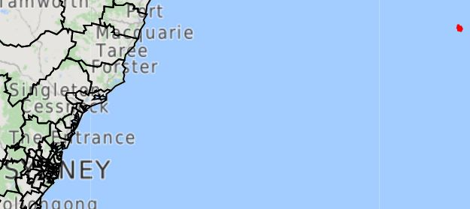
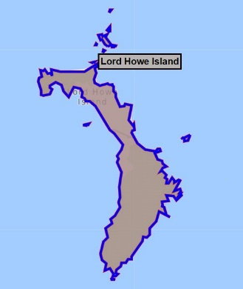
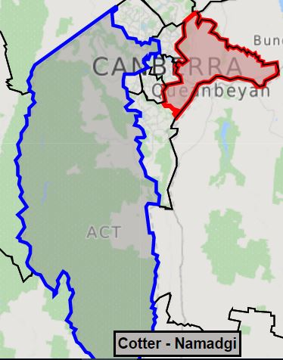
DISSIMILARITY DISTANCE
CANBERRA/L1
Mid North Coast
SA3 | Cotter Namadgi | Fyshwick Pialligo-H
Lord Howe Island | 100 | 100
 | Cotter Namadgi | 100
Lord – Howe Island
393
ACT
Fyshwick
Pialligo
Hume
745
1162
Cotter - Namadgi
Notes:
For example, if we compare
these SA3s in ACT with Lord howe Island, and we look at the population in each deciles, the Bins are not overlapping.
Therefore the comparison based on the previous distances reveals they are totally different to each other, although the residents of the red SA3 are more disadvantaged.

Slide 19
DISSIMILARITY DISTANCE
CANBERRA + SHAPE
Mid North Coast
SA3 | Cotter Namadgi | Fyshwick Pialligo-H
Lord Howe Island | 52.30 | 85.05
 | Cotter Namadgi | 78.17
Lord – Howe Island
393
ACT
Fyshwick
Pialligo
Hume
745
1162
Cotter - Namadgi
Notes:
So, to overcome this issue, we defined a distance that look at the overall shape of the curves and takes the similarity of the non-overlapping parts into account as well as that of overlapping parts.
So in this case the SA3s in the middle are more similar.
Now, that we know how to classify and compare geographies we may want to know how to group them.

Slide 20
DISSIMILARITY DISTANCE
I
N
P
U
T
POPULATION SIZE
SIZE & SHAPE
NUMBER OF CLUSTER
PAM ALGORITHM
CLUSTER ANALYSIS
OUTPUT
5-7 PEER GROUPS
Notes:
We computed the Dissimilarity distance in terms of Population size (Canberra distance) and the new distance for the SA3 geography.
Then we evaluated different number of clusters. The clustering Algorithm used was the Partitioning Around Medoids.
A cluster Analysis based on these metrics have been provided. And it turned out that a reasonable number of clusters for the SEIFA index is between 5 and 7 Peer groups.
However, as several clustering have been considered, it is advised that the users consider each option and decide which one is more suitable for their analysis. But how can we assess the goodness of a given solution?

Slide 21
CLUSTER ANALYSIS – PEER GROUPS
5 PEER GROUPS
SIZE
7 PEER GROUPS
SIZE
5 PEER GROUPS
SIZE & SHAPE
7 PEER GROUPS
SIZE & SHAPE
BEST
Notes:
For example, these figure shows the shapes of the clusters for the 5 Peer Grouping solution in the case of the simple population size and the proposed distance Size & heterogeneity.
If we simply compare the shapes and dimension of the clusters, we observe that in the case of the proposed distance the clusters are not as big as the population size and the overlapping parts are clearly less.
This difference is even more evident in the case of the 7 Peer groups clustering.
We also observe that the 7 Peer groups solution is better compared to the other.
Now I want to show you the mapping of the best solution.

Slide 22
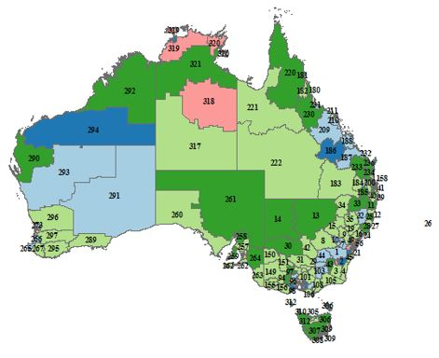
SA3- 7 CLUSTER MAPPING IRSD
62.16 %
Heterogeneous Cluster
SA3s | % SA3s | Hom | LI
68 | 20.54% | 14.86 % | 5
61 | 18.43% | 27.08 % | 7
78 | 23.57% | 30.81 % | 4
50 | 15.11% | 53.33 % | 2
11 | 3.32% | 71.33 % | 1
26 | 7.85% | 75.73 % | 9
37 | 11.18% | 50.02 % | 8
1
2
3
4
5
6
7
331
22.35 %
Homogeneous Cluster
Notes:
This map shows the geographic distribution of the SA3 clustering. The first column of the table represents the number of SA3s in each cluster and the last two represent the Homogeneity and the socio-economic classification of the cluster . We see that the percentage of SA3s in the first three clusters is more than 50 % and belong to cluster with a low value of Homogeneity.
Whereas the last three clusters are more Homogeneous with only 22% of SA3s.
However, reporting on variation across similar SA3s aims to reduce the heterogeneity of the PHN and help to compare any indicators across and within these geographic areas.

Slide 23
PHN 801 ACT
PHN 101 Central and Eastern Sydney
H = 57.16 %
H = 18.80 %
5
6
7
5
6
7
5 | 6 | 7
98.74 | 79.39 | 51.28
82.61 | 66 | 50.92
 | 59 | 50.28
 |  | 63.85
1 | 2 | 3 | 4 | 5 | 6 | 7
33.02 | 24.73 | 34.93 | 46.13 | 100 | 72.68 | 58.68
18.89 | 36.88 | 48.47 | 62.86 |  | 64.89 | 64.13
40.32 |  |  |  |  |  | 50.05
27.37
Notes:
For example, looking at these two PHNs, we observe that the homogeneity of the SEIFA distribution in ACT is much greater compared to Sydney.
As a matter of fact, the SA3s of ACT are more homogeneous compared to those of Sydney.
And it is only meaningful to compare the two PHN’s performance only by looking at the SA3s in the same clusters.
Now, as I promised, I’d like give an overview of the tool.

Slide 24
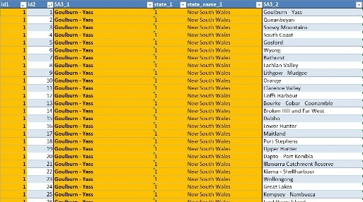
SOFTWARE ARCHITECTURE SA3 BROWSER
SA3 Distance DB
SA3 Cluster Analysis
SA3 Browser Tool
SA3 Cluster Atlas
SA3 Compare
Notes:
The primary data source for the tool is the Census but additional data will be included to provide for more robust analysis. The tool is composed of 4 modules. The SA3 compare is used to answer basic questions about human population such as:
- How many women/men live in this area?
What are their characteristics?
What is the age structure of this population?
But also information about the geography of the area such as:
The access to public transportation.
The proximity to public/private hospitals.
Access to GP.
These questions can be asked at a country level, state,PHN,ML,LHN,SA3 and soon POA.
But most importantly, The toll is customizable: meaning that we can rank or compare any geography in terms of the single variable or any combination of other variables.
In addition to being able to process data, In the Cluster Atlas and Cluster Analysis we can view and dive into the data by regions or focus on a specific cluster across all regions.
Finally in the SA3 distance Database the user can query the DB and sort all the distances for each SA3 and determine the most similar or different SA3.

Slide 25
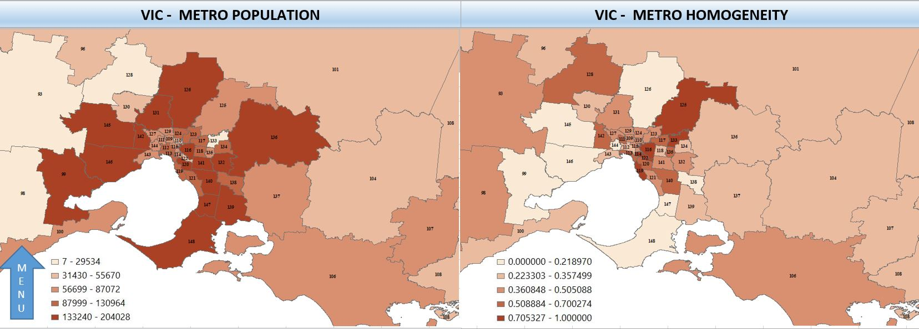
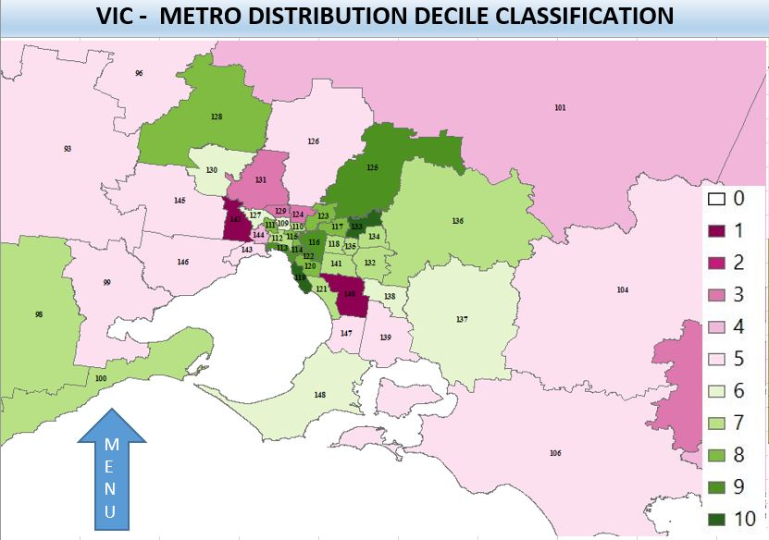
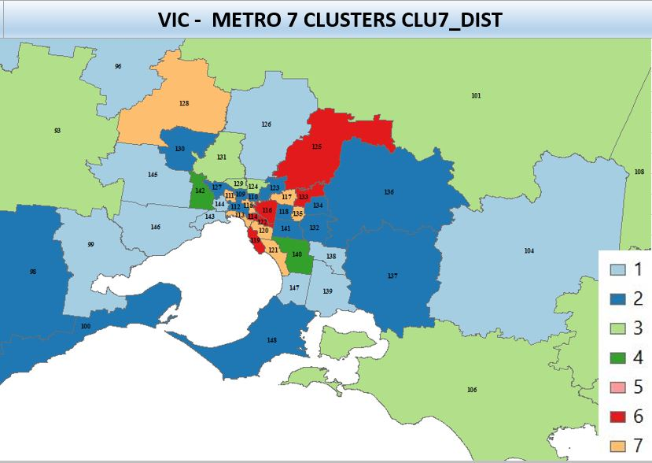
HEALTH EXPLORER: UNLOCK THE POWER OF YOUR ANALYSIS
Thank You – lpinzari@cmcrc.com
Notes:
Unfortunately, I haven’t explored all facets of the tool today but for any information about the tool you can contact me at the following e-mail address.
Currently the tool is in demo version and we are writing user documentation and there is a draft paper about the methodology and we are working on the usability testing and hoping to make it available in the next few months.
Thank You for your attention.

